Slide 1
Reducing No-Shows in Brazilian Medical Appointments

Slide 2
REDUCING NO-SHOW IN
MEDICAL APPOINTMENTS

Slide 3


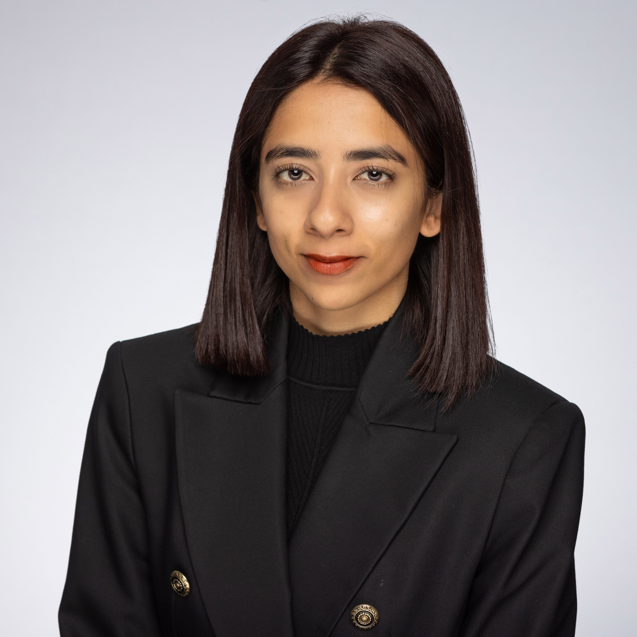
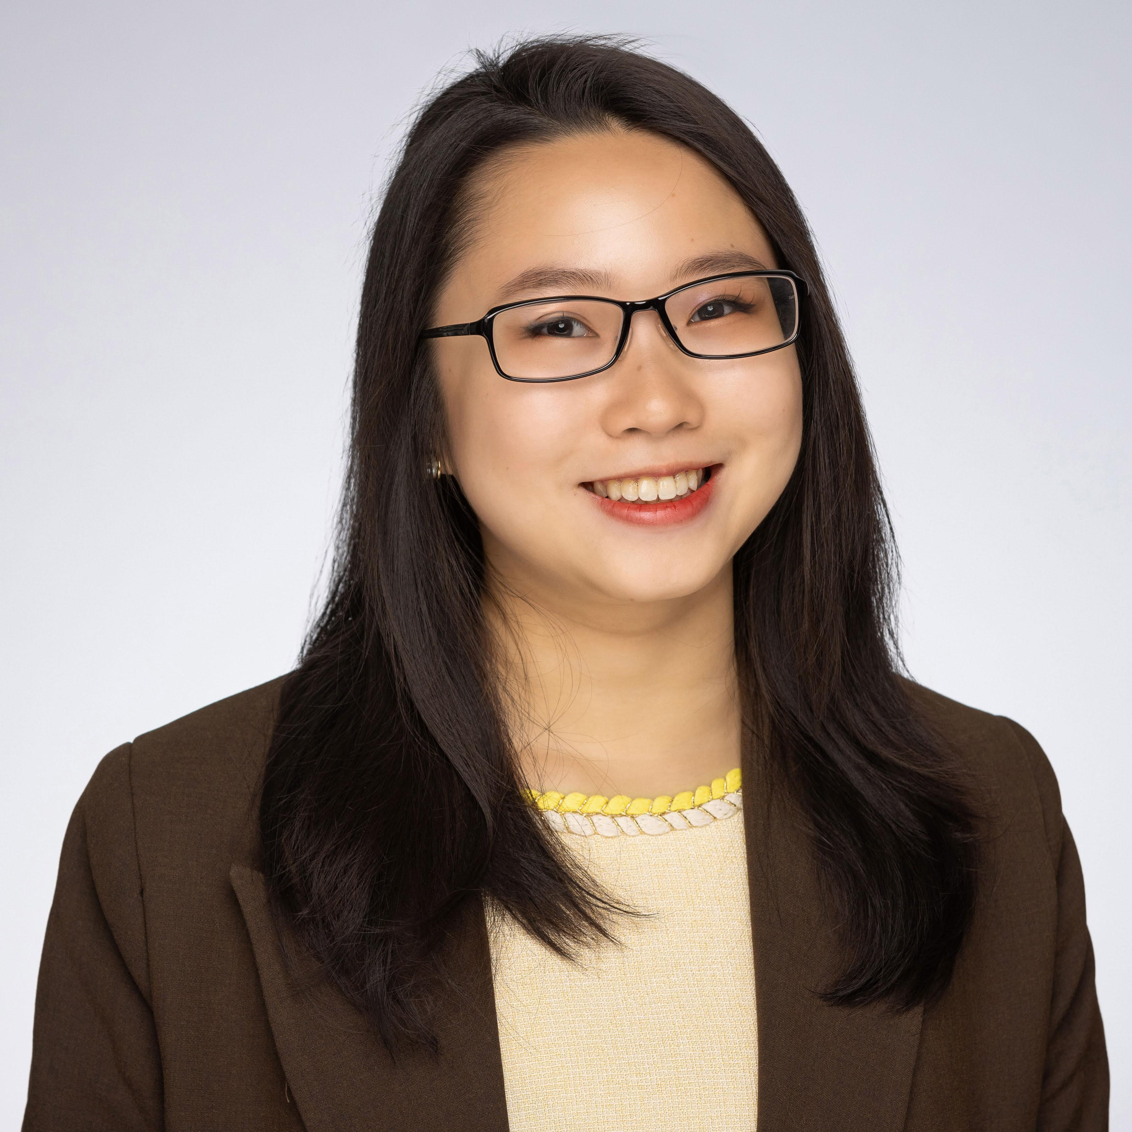
MEET THE TEAM
MMA TEAM
CAROL WANG
Github: CccarolW
NANDINI SANKARABUKTA
Github: nandinisankarabukta-git
TEHREEM NASIR
Github: Tehreemnsr
KATHERINE GONG
Github: katherine24s
GitHub Repository:
https://github.com/McGill-MMAEnterpriseAnalytics/Medical_Appointment_NoShow/tree/main

Slide 4
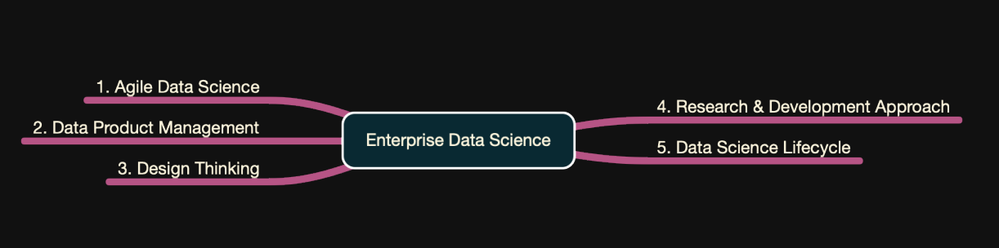
Enterprise Data Science: Data Science Lifecycle
Develop a data-driven solution the predict and reduces patient no-show rates

Slide 5
Business Context & Problem Framing
The dataset consists of medical appointment records where the target variable is No-show appointments (whether a patient showed up or not)
Key features include patient demographics (Age, Gender, Chronic Conditions), scheduling details (AppointmentDay, ScheduledDay), and external factors (Neighbourhood).
The dataset is imbalanced, requiring SMOTE for resampling
DATASET
OVERVIEW
No-shows lead to inefficiencies in healthcare systems, affecting resource allocation and patient care.
High imbalance in the dataset can lead to biased predictions
Unstructured categorical variables need transformation to enhance model performance.
KEY ISSUE
BUSINESS
OBJECTIVES
Predict and reduce no-show rates by leveraging data-driven insights
Develop a machine learning model that accurately identifies patients likely to miss their appointments
Improve resource allocation for healthcare providers by anticipating patient attendance patterns

Slide 6
Summary
Key Highlights
1
Primary Hypotheses
Patients receiving SMS reminders exhibit lower no-show rates.
Socioeconomic status (e.g., welfare program enrollment via the “Scholarship” feature) significantly influences appointment attendance.
Longer wait times increase the likelihood of missed appointments.
2
Causal Questions
Do SMS reminders causally reduce no-show rates?
How do SMS reminders affect different age groups?
How does the interaction between SMS reminders and welfare program enrollment influence attendance?
Does wait time significantly moderate the effect of SMS reminders on no-show behavior?
3
Business Value
Optimize clinic scheduling by predicting patient no-shows in advance.
Reduce revenue loss by implementing proactive intervention strategies (e.g., targeted SMS reminders).
Improve healthcare efficiency by allocating resources based on patient attendance probability.

Slide 7
Exploratory Data Analysis (EDA) & Feature Engineering
Feature Engineering
Enhancing Data Quality and Model Performance
Categorical Encoding & Transformation
Derived Features & Advanced Engineering
Created WaitTime feature to measure the gap between scheduling and appointment.
Applied rolling averages and lag features to capture temporal patterns.
One-Hot Encoding for Neighbourhood
Target Encoding & WOE Encoding to capture patterns in categorical features
Feature Hashing to handle high-cardinality categorical variables.
Polynomial Features to capture non-linear relationships.
Clustering (K-Means) to identify patterns in patient behavior
SMOTE applied to handle class imbalance in no-show prediction

Slide 8
Modelling Approach
Encoded categorical features (Gender, Neighbourhood)
Created WaitTime from appointment dates
Addressed class imbalance using SMOTE
Preprocessed the Data
Logistic Regression – Baseline Model for interpretability and comparison
Random Forest – Handles non-linearity well, reduces overfitting, performs well with numerical and categorical data
XGBoost – Advanced boosting technique, effective for imbalance data
Trained ML Models
Metrics used: Accuracy, Precision, Recall, F1-score
Goal: Improve recall to correctly predict No-show patients
Evaluated Model Performance

Slide 9
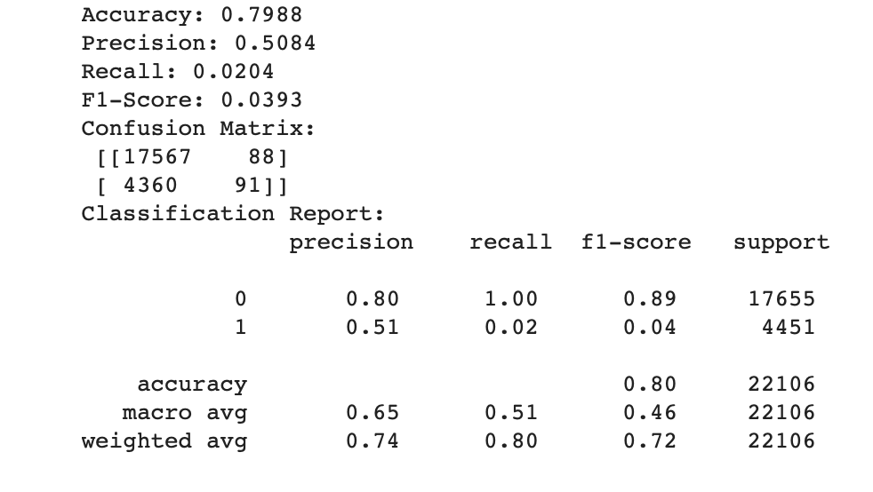
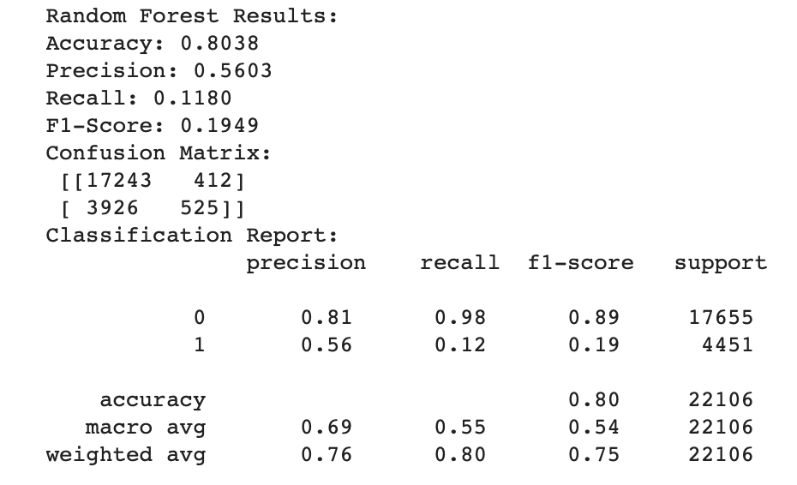
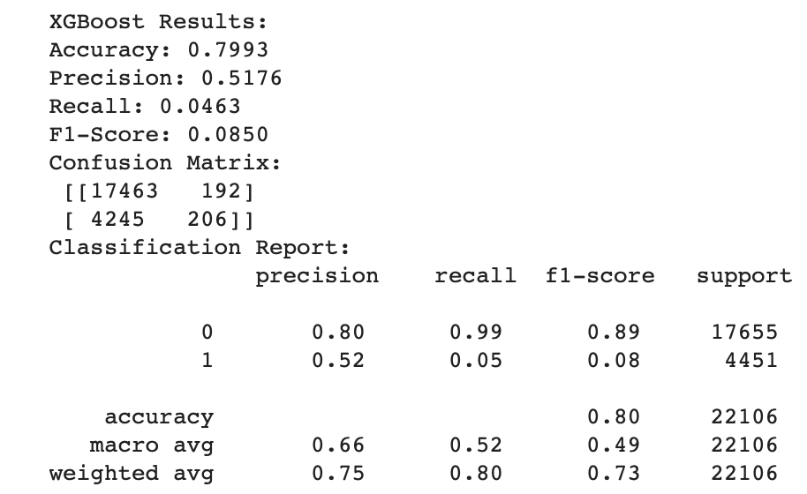
Results & Key Findings
Key Findings from Logistic Regression
Very low recall (0.0204) → Fails to identify no-shows.
High false negatives (4,360 cases) → Majority of no-show patients are misclassified as "show".
Accuracy (79.88%) is misleading → Model is biased towards predicting "Show".
Not suitable for handling imbalanced data.
Key Findings from Random Forest
Better recall (0.1180) than Logistic Regression → Identifies more no-show cases.
Higher precision (0.5603) → More reliable predictions.
Lower false negatives (3,926 vs. 4,360 in Logistic Regression).
Achieves the best balance between recall & precision, making it the preferred model.
Key Findings from XGBoost
Slightly better precision (0.5176) than Logistic Regression but lower than Random Forest.
Recall (0.0463) is still low → Fails to identify many no-show cases.
Higher false negatives than Random Forest → Still struggles with class imbalance.
Performs better than Logistic Regression but does not outperform Random Forest.
Notes:
Nandini

Slide 10
Causal Inferences
Causal Questions: Do SMS reminders causally reduce no-show rates?
Meta-Learners: T-Learner, X-Learner, S-Learner (using Gradient Boosting)
Treatment: SMS_received
Confounders:
Age, Gender_Encoded, WaitTime, Hipertension, Diabetes, Alcoholism, Handcap, Cluster_KMeans_2, Scholarship
APPROACH
T-Learner ATE: 0.0578
X-Learner ATE: -0.0555
S-Learner ATE: -0.1158
ATE ESTIMATES
T-Learner Placebo ATE: 0.0132
Detects spurious effects, suggesting possible overfitting or noise.
X-Learner Placebo ATE: 0.0013
Close to zero, meaning it is more robust to bias and spurious correlations.
PLACEBO TREATMENT

Slide 11
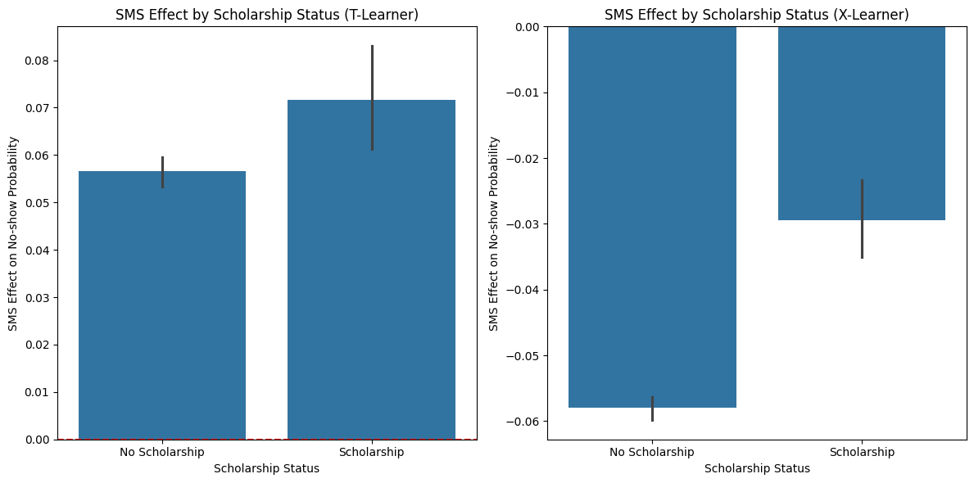
CATE Analysis
For X-learners, both bars are negative, meaning the SMS treatment lowers the likelihood of no-show regardless of scholarship status.
Patients without scholarships are more responsive to SMS reminders and show up more often when reminded.
Notes:
Katheirne

Slide 12
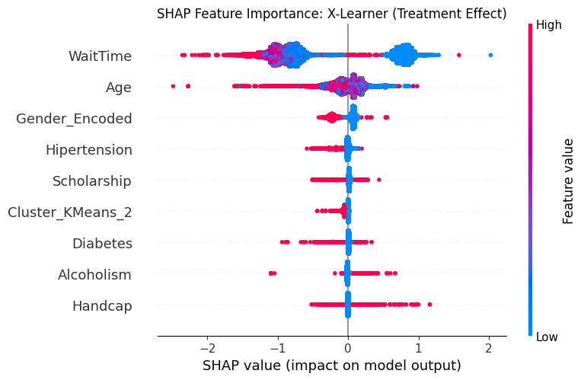
SHAP Analysis
Patients with long wait times benefit more from SMS reminders, as it reduces their probability of no-show.
Older patients experience a greater reduction in no-show probability when they receive an SMS reminder.
Notes:
Katheirne

Slide 13
Threats to Validity
Predictive Model Limitations
The predictive models all struggle with identifying no-show cases, with low recall(0.02-0.12), which may compromise causal inference validity
Selection Bias: SMS reminders may not be randomly assigned to patients
Certain types of patients (younger, tech-savvy) might be more likely to receive SMS
T-Learner's positive ATE (0.0578) contrasts with other models, suggesting potential bias
Temporal Aspects
The analysis doesn't account for potential temporal trends or seasonality in appointment no-shows, which could confound the relationship between SMS reminders and attendance.
The causal effect of SMS reminders might vary over time as patients become accustomed to receiving them.
External Validity
Results may not generalize to different healthcare settings or patient populations
SMS effectiveness might depend on cultural and socioeconomic factors
Model Assumptions & Methodological Issues
SMOTE resampling for class imbalance may introduce artificial patterns
Placebo tests suggest T-Learner may detect spurious effects (placebo effect: 0.0132)

Slide 14
Conclusions & Recommendations
Conclusions:
Overall Causal Effect: SMS reminders generally reduce no-show rates
2. Heterogeneous Effects: The causal effect of SMS reminders varies across different patient subgroups:
Age Groups: SMS reminders appear most effective for young adults and adults, with less impact on children and the elderly.
Scholarship Status: Patients with scholarships show a stronger response to SMS reminders.
Wait Time: Patients with longer wait times show greater reduction in no-shows
Recommendations:
Targeted SMS Strategy: Focus on young adults and adults (18-65 years) / patients with longer wait times (>median) / without scholarship support
Heterogeneous Effects:
Send additional reminders for appointments with longer wait times
Customize SMS(Tailor SMS content / Tiered reminder system)
Implementation & Research:
Use X-Learner over T-Learner for future analyses (more robust results)
Conduct randomized controlled trial to address selection bias
Establish monitoring system to track ongoing SMS effectiveness
Notes:
Carol

Slide 15
QUESTIONS

